Slide 1


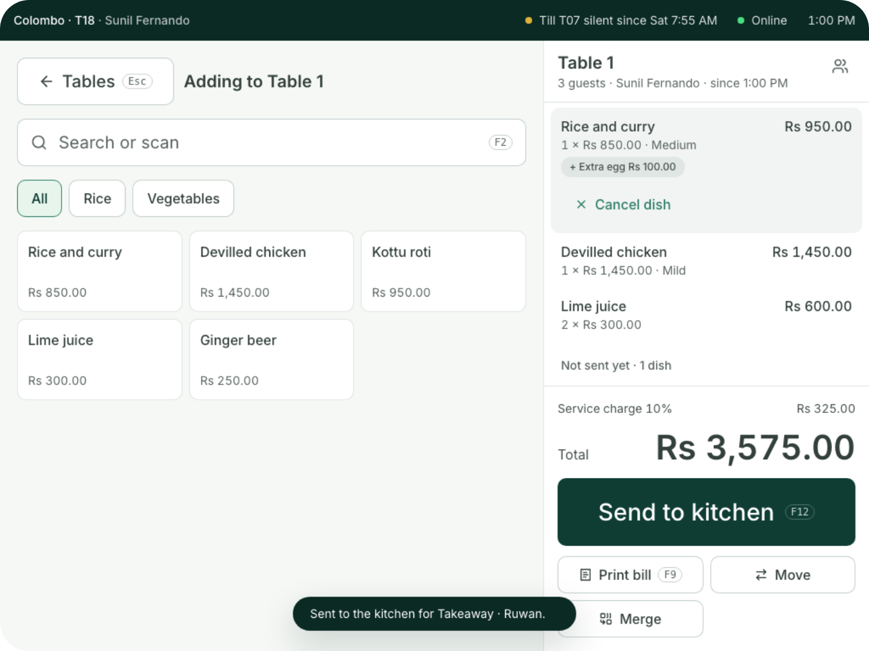
For restaurants
You serve.
Coredile does the
rest.
Tables, waiters’ phones, kitchen tickets, split bills and food cost,
in one system that keeps going when the internet drops.
Notes:
Thank you for your time today. I’m going to show you Coredile POS for restaurants. It takes the order at the table, sends it to the kitchen, prints and splits the bill, and works out what every plate costs you. In the next few minutes you’ll see how it saves time on a busy night, and how it shows you where your money goes. Please stop me and ask questions at any time.

Slide 2




THE USUAL WAY
A busy night costs more than it should.
Orders on paper, bills on a calculator, and food cost a guess.
Orders lost on the
way to the kitchen
Split bills worked
out on a calculator
Dishes cancelled,
and nobody knows
why
Guessing what
each plate really
costs
Coredile takes care of all of this, with every order.
Notes:
On a busy night, most restaurants still run on paper. A waiter writes the order and walks it to the kitchen, and sometimes it gets lost or read wrong. At the end, someone works out the split bill on a calculator. Dishes get cancelled and the owner never hears why. And most owners are not sure what one plate really costs them. Ask them: which of these happens in your restaurant?

Slide 3





THE BIG IDEA
One order. Five jobs done for you.
Kitchen and bar
Kottu to the kitchen, Milo to the bar
Table 4
Paid in cash
Stock
2 × Chicken kottu
2,200
Chicken, rotti, eggs and Milo come off
2 × Iced Milo
900
Food cost
Service charge 10%
310
Rs 1,180 of ingredients on this bill
Accounts
Total
Rs 3,410
Sale, service charge and cash written in
Morning email
Yesterday’s sales and guests, at 7 a.m.
Notes:
This is the heart of Coredile. The waiter or cashier does one thing: put in the order. Then Coredile does five jobs by itself. The kottu goes to the kitchen and the Milo goes to the bar. The chicken, rotti, eggs and Milo come off the stock. It works out what the food cost you. It writes the sale and the service charge into the accounts. And tomorrow at 7 in the morning, the owner gets an email with yesterday’s sales and how many guests came. Nobody types anything twice. (In Present mode, each job appears one by one as you click.)

Slide 4
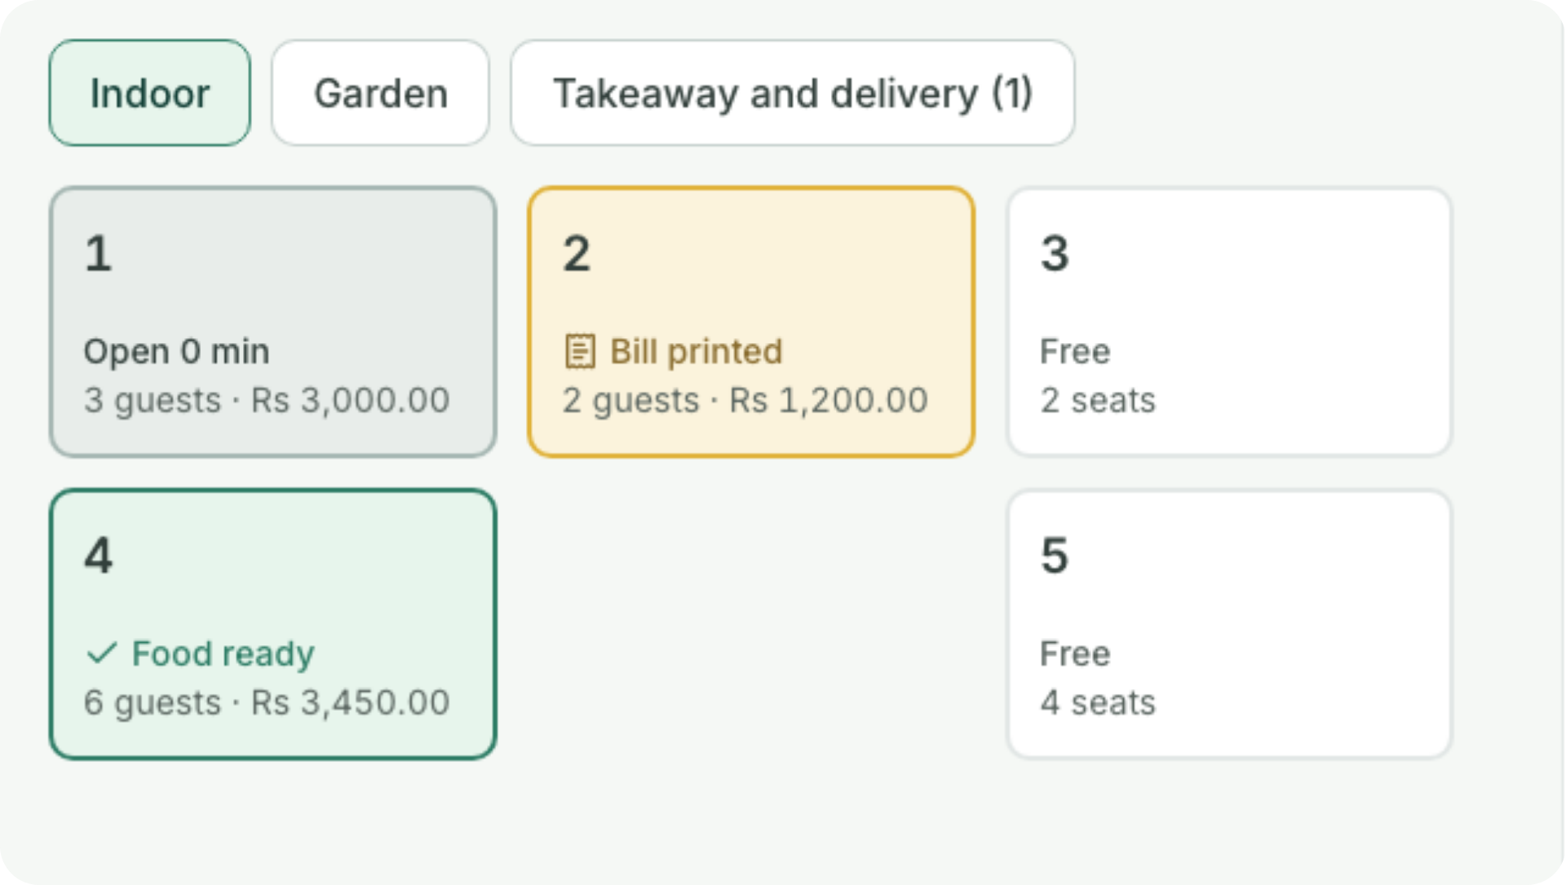
ON THE FLOOR
Every table
at a glance.
Free
Ready for the next guests
Open
Guests, time and the bill so far
Food ready
The kitchen is done. Take it out.
Bill printed
Waiting to pay
Move a table, or merge two into one bill. Takeaway
and delivery orders go by name.
Notes:
In a restaurant, the till opens on the table plan. At a glance you see every table: which ones are free, which have guests and how long they’ve been there, where the food is ready to go out, and which tables have their bill printed and are waiting to pay. You can move a table, or merge two tables into one bill. Takeaway and delivery orders go by the customer’s name instead of a table.

Slide 5
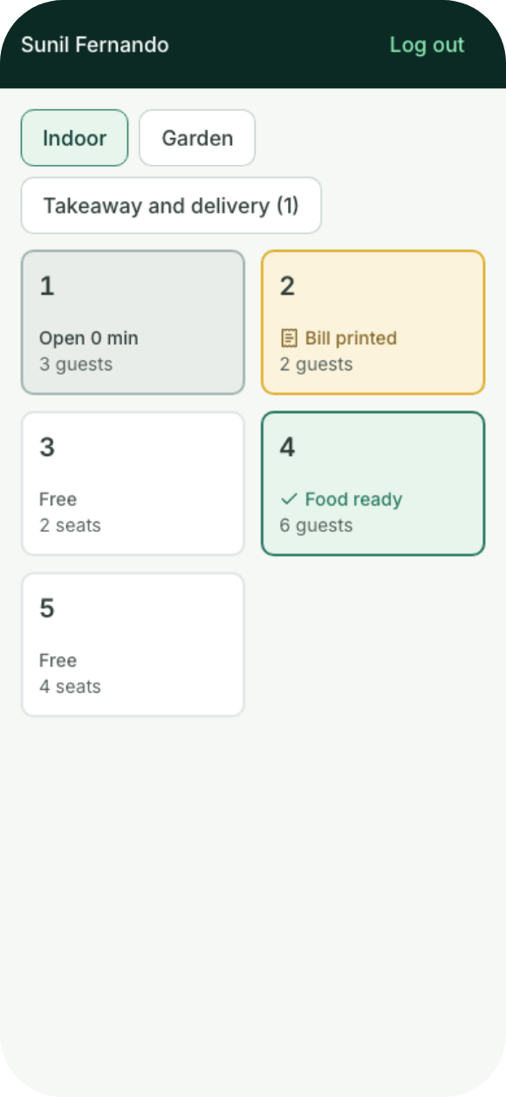
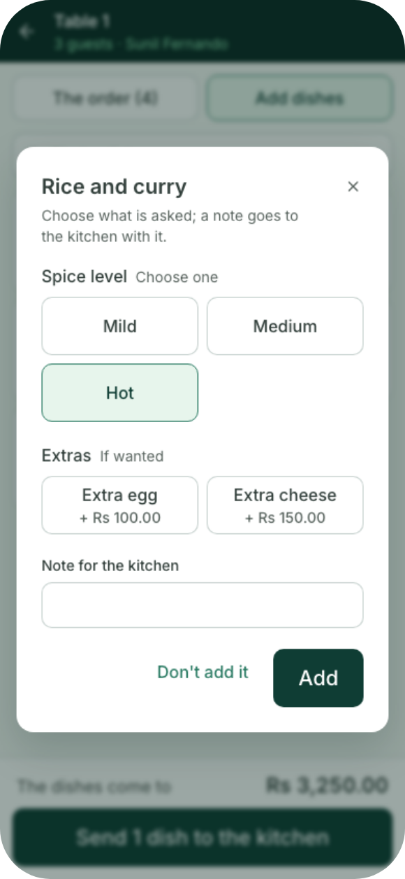
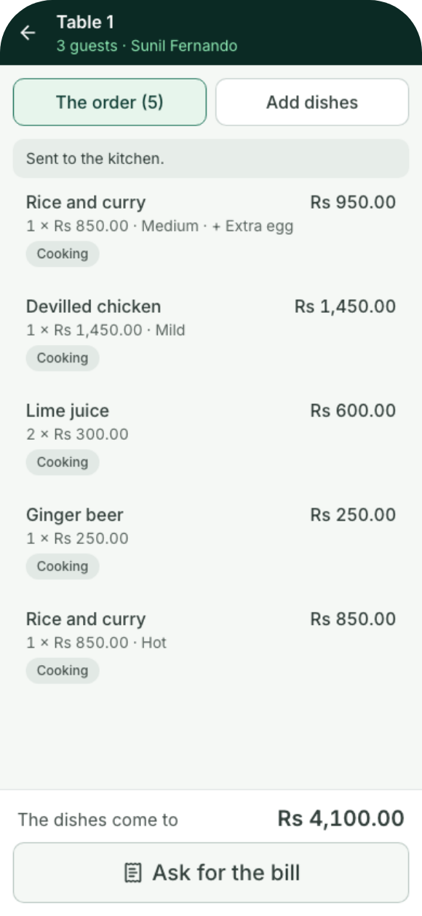

WAITERS
Orders taken
at the table.
On their own phones. Nothing to install.
Each waiter logs in with their own PIN
Spice level, extras and a note for the kitchen
The kitchen has it a second later
They see when food is ready, and ask for the
bill
Notes:
Waiters take orders on their own phones, right at the table. There’s no app to install: we pair each phone once with a code, and each waiter logs in with their own PIN. They pick the dish, the spice level, any extras such as an extra egg, and a note for the kitchen. A second later, the kitchen has it. No more running back and forth with paper. When the food is ready, the phone shows it, and the waiter can ask for the bill from the phone. It all runs on your own network, so it keeps working without internet too.

Slide 6
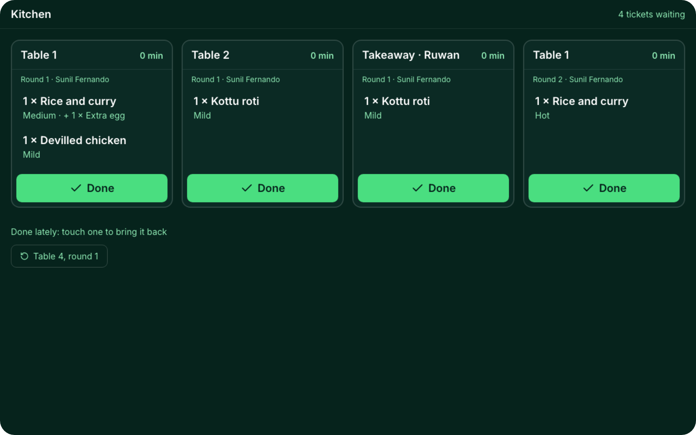

IN THE KITCHEN
Every order, in the right order.
Kitchen and bar each get only their own
dishes
A printed ticket, a screen, or both
Oldest first. Amber after 10 minutes, red
after 20
One touch marks it done, and the waiter
sees it
Notes:
In the kitchen, each station gets only its own dishes: the kottu goes to the kitchen, the drinks go to the bar. Each station can have a printer, a screen, or both. Most kitchens start with a printer, as they do today. On the screen, tickets show oldest first. A ticket turns amber after 10 minutes and red after 20, so nothing waits too long. The cook touches Done, and the waiter’s phone shows the food is ready. If a dish is cancelled, the kitchen gets a ticket saying so.

Slide 7






WHEN THE INTERNET DROPS
No internet? Keep serving.
One till holds every open order. Phones, screens and printers reach it over your own network, for up to 3 days
without internet.
Other tills
Kitchen printer
Each keeps a copy
Tickets for the cooks
Front-counter till
Waiters’ phones
Bar printer
Orders from the table
Holds every open order. If it breaks,
another till takes over.
Tickets for the drinks
Kitchen screen
The internet
Tickets, oldest first
Bills go up when it’s back
Notes:
Power cuts and internet problems happen, often on the busiest night. Coredile does not need the internet to serve. One till, usually at the front counter, holds every open order. The other tills, the waiters’ phones, the kitchen screen and the printers all talk to it over your own network. When the internet comes back, every bill is sent up by itself, in order. Nothing is lost. A till can work for up to 3 days without internet. And if that front-counter till breaks, a manager makes another till take over, and service carries on.

Slide 8
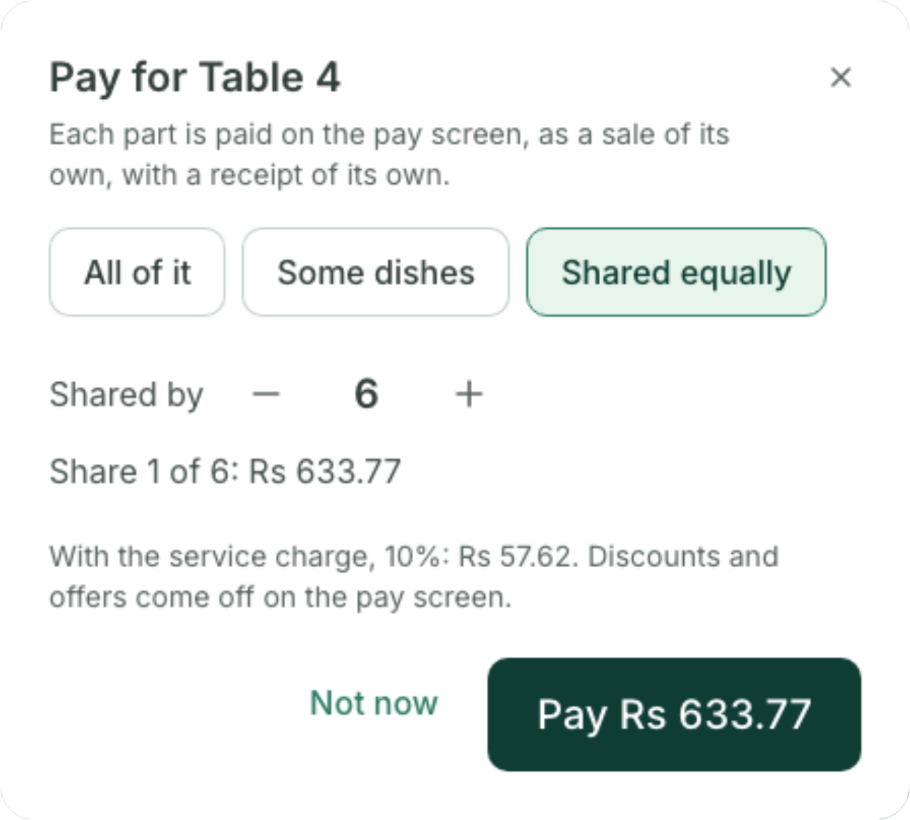
THE BILL
Split the bill any way they ask.
1
All of it
One bill for the whole table
2
Some dishes
Each guest pays for what they had
3
Shared equally
Between any number of guests
The service charge prints as a line of its own
Two tills can never take money for the same dishes
Notes:
At the end of the meal, the table asks for the bill. It prints with the service charge as a line of its own. If they want to split it, the till does the sums: one bill for the whole table, each guest pays for their own dishes, or the bill is shared equally between any number of people. Each part gets its own receipt and can be paid by cash or card. Two tills can never take money for the same dishes, and when the last part is paid, the table is free again.

Slide 9
FOOD COST
Know what every plate costs you.
Tell Coredile what goes into a dish, once.
Chicken fried rice, one plate
From then on, every plate you sell takes its
ingredients off the stock and counts what they cost.
Basmati rice
180 g
Rs 117
Chicken
120 g
Rs 168
When chicken goes up, you see it in your profit that
week. Not at the end of the year.
Egg
1
Rs 45
Vegetables
80 g
Rs 48
Recipes come with the Restaurant plan.
Oil, garlic and spices
Rs 38
Costs you
Sells for
You keep
Rs 416
Rs 1,250
Rs 834
Notes:
Most owners guess their food cost. With Coredile, you enter the recipe once: how much rice, chicken, egg and so on goes into one plate. After that, every plate sold takes those ingredients off the stock and counts their cost. Here, a plate of chicken fried rice costs Rs 416 to make and sells for Rs 1,250, so you keep Rs 834 before wages and rent. If the price of chicken goes up, you see it in your profit the same week. Recipes are included in the Restaurant plan, at no extra cost.

Slide 10
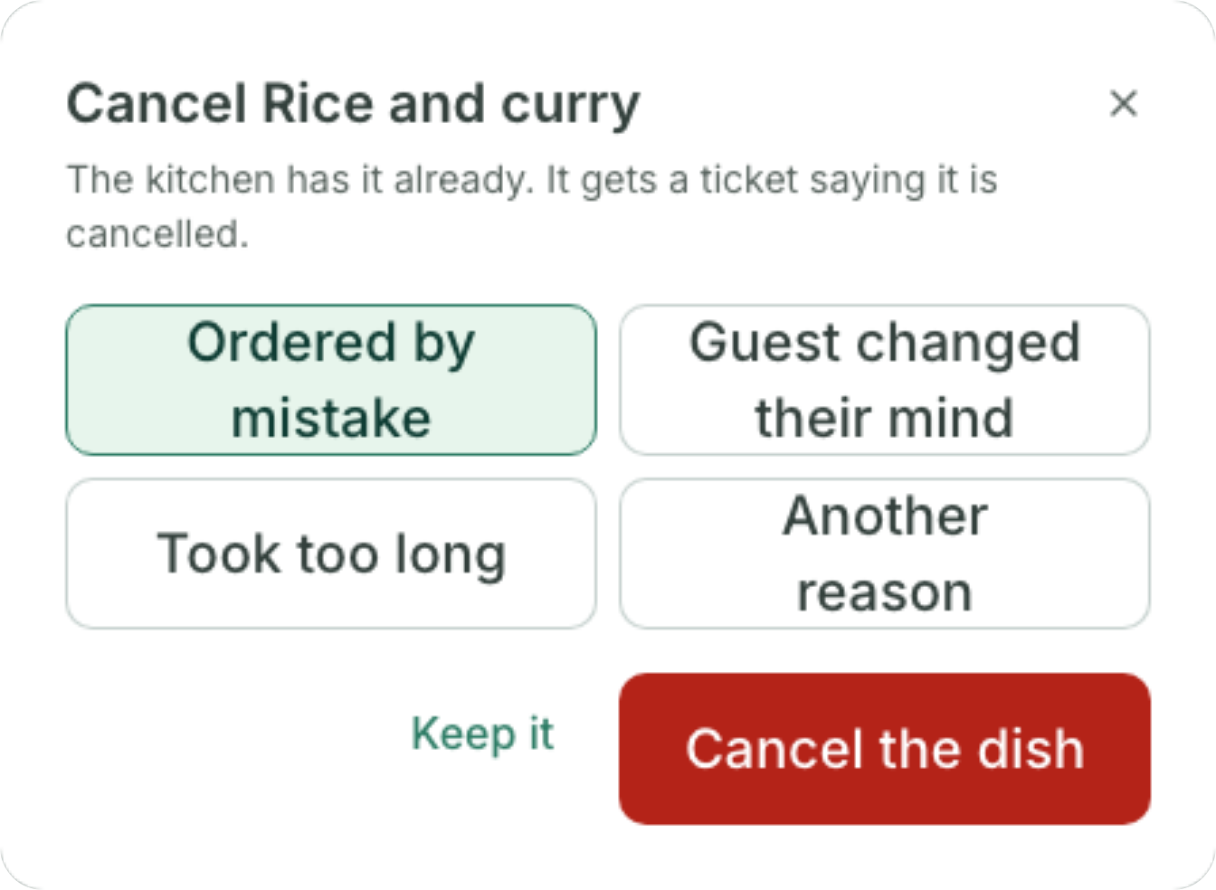




CANCELLED DISHES
Every cancelled dish has a reason.
Once the kitchen has a dish, only a manager can cancel it
A reason is chosen every time
The kitchen gets a ticket, so it stops cooking
A report shows each one: when, who, and why
Notes:
Cancelled dishes are where money quietly disappears. With Coredile, a waiter can cancel a dish only before it reaches the kitchen. Once the kitchen has it, cancelling needs a manager, and a reason: ordered by mistake, the guest changed their mind, it took too long, or something else. The kitchen gets a ticket so they stop cooking. And the owner sees a report of every cancelled dish: when, who did it, who allowed it, and why.

Slide 11
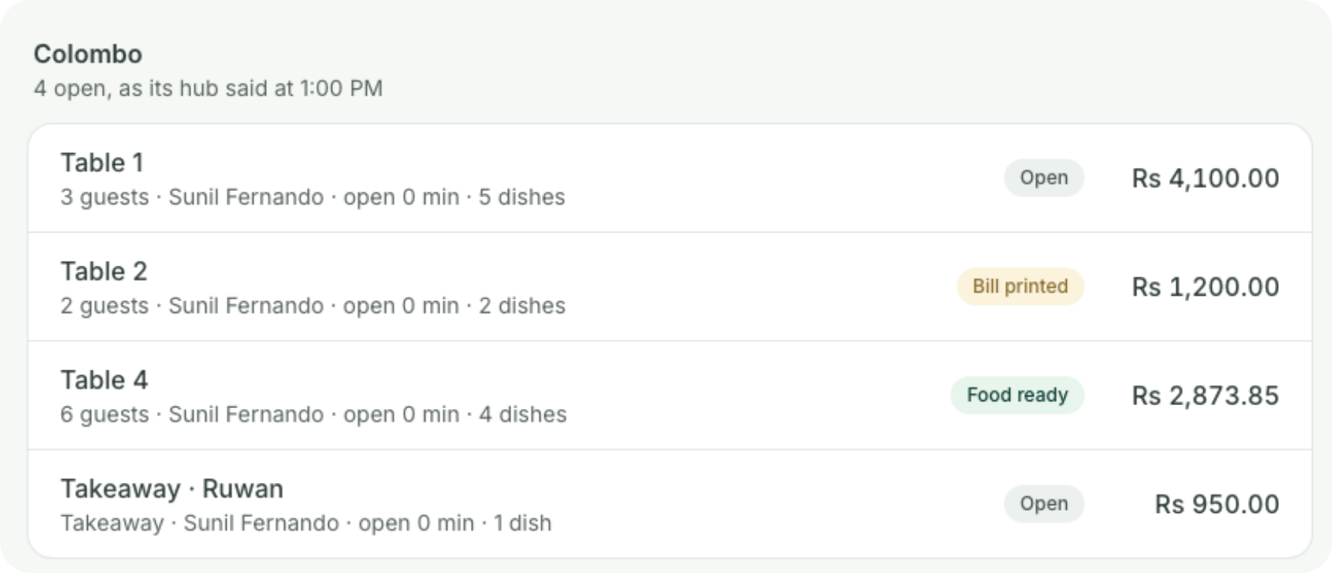



FOR THE OWNER
Your restaurants, from your phone.
Coredile POS
7:00 a.m.
Yesterday at Spice Garden
Good morning, Kamala. Here’s how yesterday went.
Rs 486,250
+12% on last Friday
Guests served
Spend per guest
296
Rs 1,480
What’s open right now, in every branch
3 dishes were cancelled after the kitchen had them
Sales by table, area and waiter
How long the kitchen takes, hour by hour
Notes:
The owner doesn’t need to be at the restaurant to know what’s happening. Every morning at 7, an email arrives with yesterday’s sales, how many guests came, and how much each guest spent on average. Any time, the owner can see what’s open right now in every branch: which tables, how many guests, and the bill so far. Reports show sales by table, area and waiter, and how long each kitchen station takes, hour by hour. And each staff member only sees the screens their job needs.

Slide 12


STOCK AND ACCOUNTS
The books keep themselves.
Stock
Accounts
Ingredients come off with every dish sold
Profit and loss, for any month
See what’s running low before it runs out
What you owe each supplier
Order from suppliers, and check what arrives
A VAT and SSCL summary each month
Count the store room and see what went missing
Any report downloads for Excel
Notes:
No more counting the store room by hand every week. Because every dish has its recipe, each plate sold takes its ingredients off the stock. You see what’s running low before it runs out, order from your suppliers, and check what actually arrives. When you do count, Coredile shows you what went missing. On the accounts side, every bill, delivery and refund writes itself into the books as it happens. So at any time you can see your profit and loss and what you owe your suppliers, and every month there’s a VAT and SSCL summary for your accountant. Any report can be downloaded for Excel.

Slide 13
WHAT CHANGES
Your night, before and after.
Without Coredile
With Coredile
Orders
Written on paper
Sent from the waiter’s phone
Split bills
Done on a calculator
Done by the till
Food cost
A guess
Known for every plate
Cancelled dishes
Nobody knows why
A reason for every one
Internet down
Billing stops
Service carries on
The owner
Phones the manager
Gets one email at 7 a.m.
Notes:
Here is the simple picture. Without Coredile, orders are written on paper, split bills are done on a calculator, food cost is a guess, cancelled dishes go unexplained, billing stops when the internet goes down, and the owner has to phone the manager to find out how the night went. With Coredile, all of that happens by itself while you serve. You save time every night, and you stop losing money you can’t see.

Slide 14
PRICE
One price per restaurant.
No charge per waiter, per dish or per bill.
Restaurant
Extra till
Rs 1,500 a month
Rs 8,500
a month per branch, with two tills
Offers and Loyalty, if you want it
Rs 2,000 a month
Tables and kitchen tickets
Waiters’ phones and kitchen screens
Split bills and service charge
Recipes and food cost
Pay yearly
Stock and suppliers
Accounts and every report
2 months free
Setup and training are agreed with you, in writing, before we start. Prices in Sri Lankan rupees; VAT is added if it applies.
Notes:
Our price is simple. A restaurant pays one price per branch, per month: Rs 8,500. That includes two tills, the tables and kitchen tickets, the waiters’ phones and kitchen screens, split bills and the service charge, recipes and food cost, stock, suppliers and the accounts. There is no extra charge for more waiters, more dishes or more bills. If you need a third till, it is Rs 1,500 a month. Offers and Loyalty, for deals, points and gift cards, is Rs 2,000 a month per branch, only if you want it. If you pay for a year, you get 2 months free. Setup and training depend on your restaurant, and we agree that price with you in writing before anything starts.

Slide 15
WHAT YOU NEED
Simple to start.
You bring
We do
A Windows PC or laptop for each till
Load your menu and recipes, from Excel or even
a printed menu
A receipt printer at each till
Set up your tables, kitchen and bar
A network printer in the kitchen and the bar
Train your cashiers, waiters and cooks
Good Wi-Fi. Waiters use their own phones.
Answer when you call us for help
No hardware yet? We’ll give you a price for all of it.
You check everything before you start serving.
Notes:
Getting started is easy. You need a Windows PC or laptop for each till, and a receipt printer. For the kitchen and the bar, a network printer each, so the tickets print where the food is made. If you’d like a kitchen screen too, any tablet or screen with a web browser will do. Waiters use their own phones over your Wi-Fi, so there is nothing extra to buy for them. If you don’t have the hardware yet, we can give you a price for all of it. We do the hard part: we load your menu and recipes, even from an Excel sheet or a printed menu, set up your tables, kitchen and bar, and train your staff. And when you need help, you call us.

Slide 16

GETTING STARTED
Four simple steps.
1
2
3
4
Free demo
Agree the price
We set it up
Start serving
We show you Coredile with
dishes and tables like yours.
You get the setup and training
price in writing.
We load your menu, set up
your tables and kitchen, and
train your staff.
Pay by the month or by the
year.
No long contract. You pay month by month, or pay for 10 months and use it for 12.
Notes:
Here is how we start. First, a free demo, like today, with dishes and tables like yours. Second, we agree the setup and training price, and you get it in writing. Third, we come and set everything up: we load your menu and recipes, set up your tables, kitchen and bar, and train your staff. Fourth, you start serving. There is no long contract. You pay month by month, or pay for a year and get 2 months free. The tills start billing once the first invoice is paid, and each invoice is emailed to you 10 days before it’s due.

Slide 17




WHO MAKES IT
Built in Sri Lanka,
by people you can call.
Your data is backed up every day
8
80+
No other business can ever see your data
Updates come to you, at no extra cost
years building software for
businesses
projects delivered
Help from the people who built it
Notes:
Coredile POS is made by Coredile, a Sri Lankan software company. We have spent 8 years building software for businesses, and delivered more than 80 projects. Your data is backed up every day, and no other business can ever see it. Updates come to you at no extra cost. And when you need help, you talk to the people who actually built the system, not a call centre.

Slide 18

NEXT STEP
Book your free demo.
We’ll show you Coredile with dishes and tables like yours. Bring all your questions.
EMAIL
WEBSITE
WHATSAPP
hello@coredile.com
coredilepos.cloud
+94 72 282 2060
Notes:
Thank you. The best way to see if Coredile is right for you is a free demo with dishes like yours. We can do it at your restaurant, or here. Ask: when is a good day for you this week? Leave the contact details with them, and write down how many tables, tills and branches they have so the demo is ready for them.

